Slide 1

Welcome to My Presentation
National Polymer Industries PLC.
MEHADI HASAN
DEPARTMENT OF ACCOUNTING & INFORMATION SYSTEMS
BATCH-29 (OFFICE APPLICATION)

Slide 2
Mission and Vision
VISION
Our vision is to establish NATIONAL POLYMER INDUSTRIES PLC. as a role model in the Plastic Industry of Bangladesh with innovative quality products, services and solutions.
MISSION
Our corporate mission is to be the eminent manufacturer of the best quality products for our existing and potential customers through: Product leadership; Excellent value and Superior quality services.

Slide 3
Core Values
CORE VALUES
Shareholders: Create sustainable value for our shareholders by utilizing an honest and efficient business methodology;
Customers: Render quality services to our customers by using the state-of-the-art technology, offering diversified quality products to fulfill their needs to the best of our abilities;
Employees: Be reliant on the inherent talents of the employees. Work together to attain goal and reward the skills and talents of everyone at the work place; and
Community: To serve the society through employment generation with equal opportunities, support the community and be a responsible corporate citizen. .

Slide 4
Products category
National Polymer Industries PLC. offers a diverse range of products category:
Building Materials
Pipe & Fitting
Door
Water Tank
Water Tap
Furniture
PVC Sheet
Household
Houseware

Slide 5
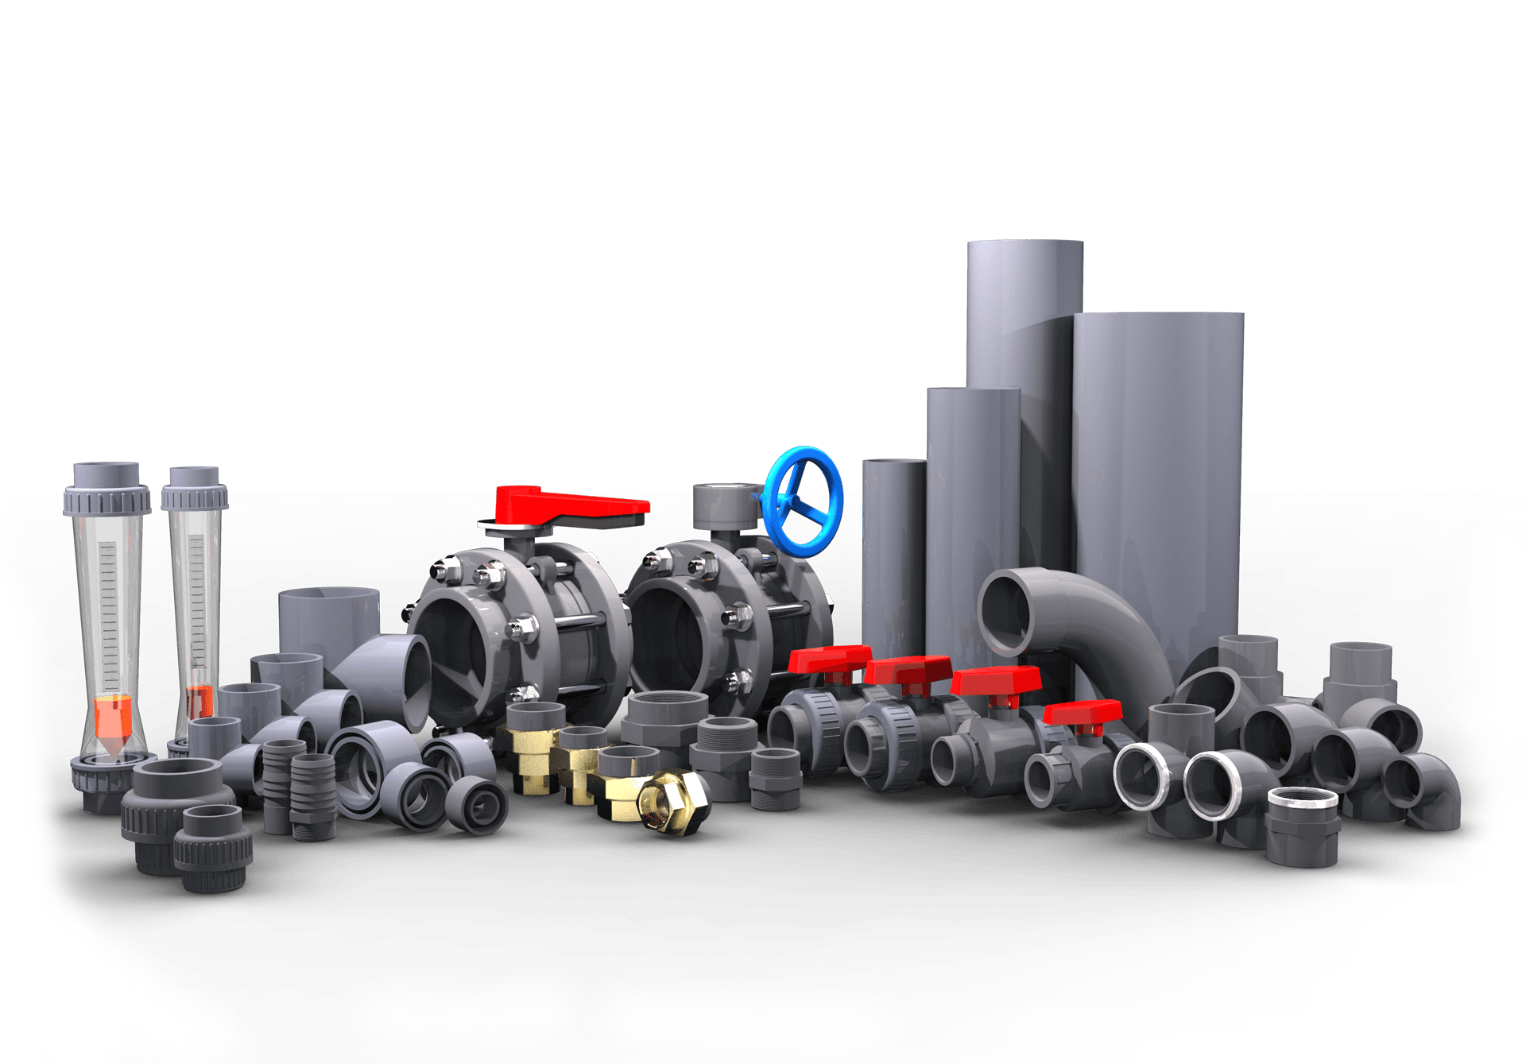
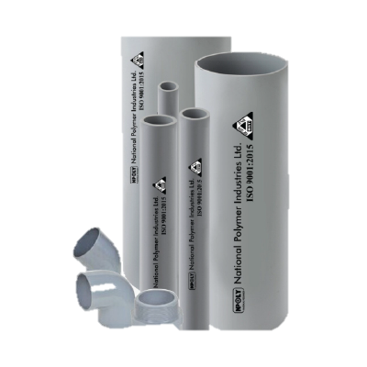
Upvc Fittings and Pipe

Slide 6
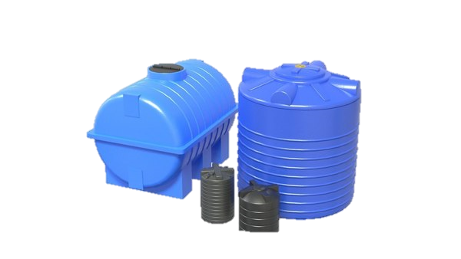
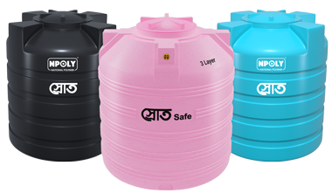
Water Tank

Slide 7


Upvc Door

Slide 8

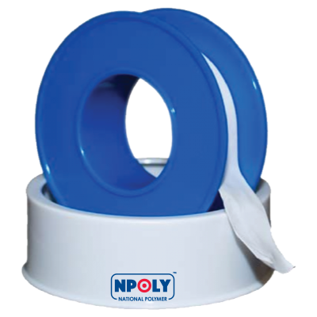
Bathroom Fittings
Taplon Tape

Slide 9
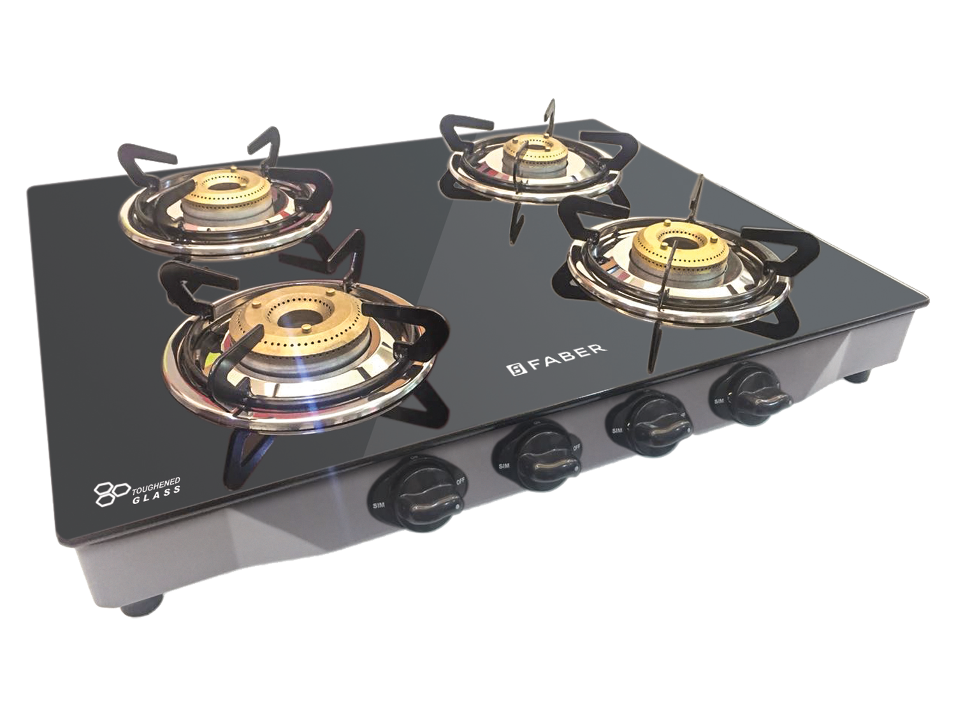
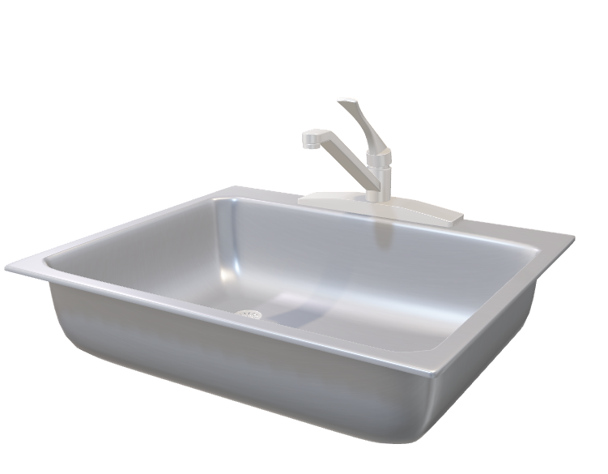
Gas Stove
Kitchen Sink

Slide 10
Flow Chart of Business Plan of National Polymer Industries PLC.
Sales Strategy
Distribution and Logistics
Customer Service
Financial Planning
Market Research
Product Development
Production Planning
Marketing Strategy
Monitoring and Evaluation

Slide 11
Product Sales Report
Product Name | Total
Bathroom Fittings | 49958
Gas Stove | 80331
Kitchen Sink | 37656
Taplon Tape | 29903
Upvc Door | 38730
Upvc Fittings | 288582
Upvc Pipe | 73851
Water Pump | 3485943
Water Tank | 63218
Grand Total | 4148172

Slide 12
Statistics of sold products in the last 3 months ( January – March 2024)
Month | Total
Jan | 3835403
Feb | 145286
Mar | 167483
Grand Total | 4148172

Slide 13
Area Sales Report
Area | Total
Barishal | 306663
Chittagong | 74760
Dhaka | 116942
Khulna | 3615495
Mymensingh | 34312
Grand Total | 4148172

Slide 14
THANK YOU

